Slide 1

Capstone Presentation
By: Jacob Botelho, Lance Lespinasse, Justin Ramos, Elvis Kibet

Slide 2

Our idea
We decided to create a movie site based off Jacob's proposal. Created to give people the freedom to get their ideas of films out there in the world.

Slide 3


Project Concept
- Movie Site
Allows users to Upload their own movie ideas
Home Feed
Share Movie idea
Stars for rating
Followers/Following

Slide 4
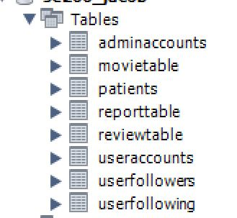
Our database tables.

Slide 5
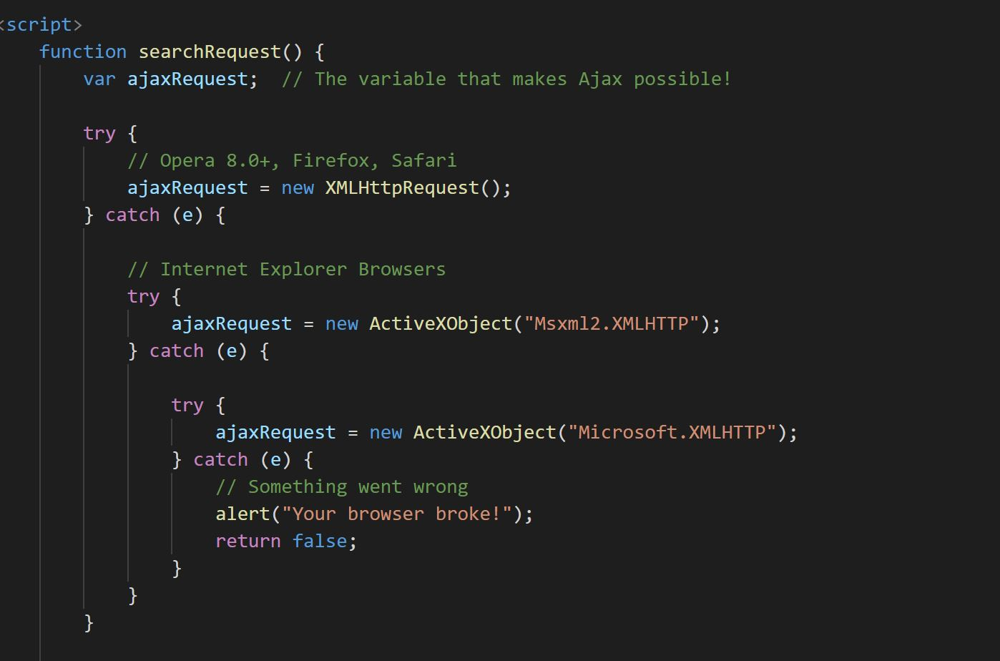
Search functionality.

Slide 6
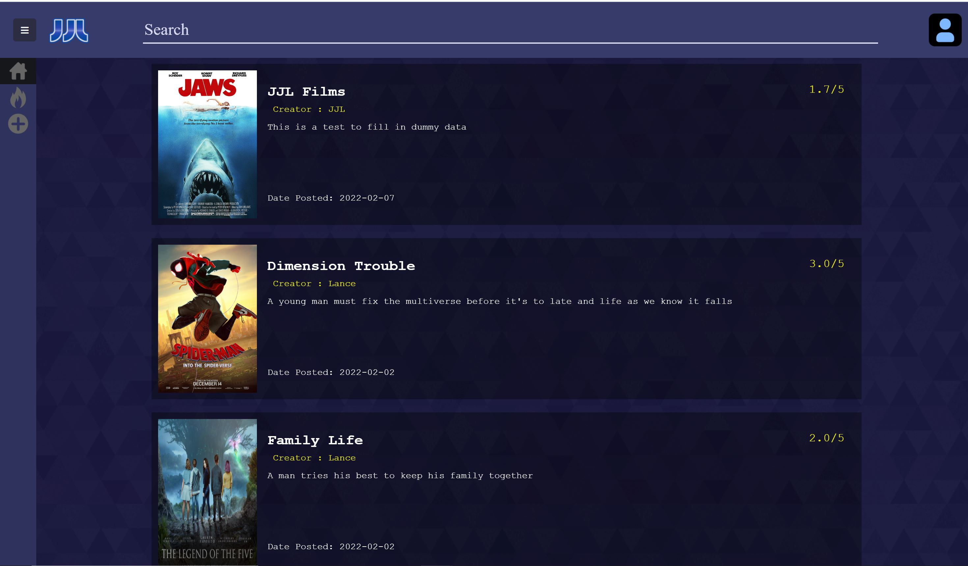
Featured site

Slide 7

Our success
-Communication improved.
-Site like FIGMA
-Implementing other people's ideas from UX/UI
-Working as a team
-Fixed Errors quickly

Slide 8
Our failures
-Underestimating the time, we needed
-Communication in the beginning
-Highlights Page problems
-Simple idea is more difficult then intended

Slide 9

Roadblocks that we had
- Search functionality
Signup Bug
Database issue
Login Issue
Profile Page error

Slide 10
What we would do differently
1
Planning
Something in the timeframe we had
Make better decisions
2
What we needed to focus on
3
Meet more frequently
Majority of our work was done in class.

Slide 11
Growth
How to create an idea with a team
Communication
Helps us expect how a fast a timeline can come
Time Management

Slide 12
Questions?

